Slide 1

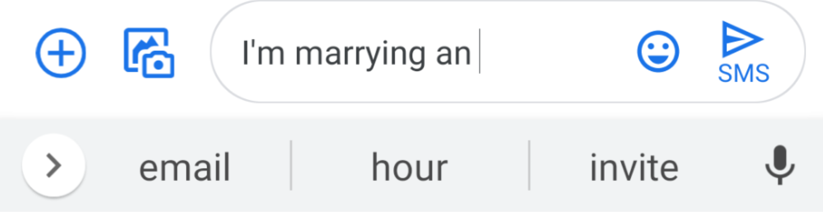
Machine Learning Systems Design
Lecture 2: Designing an ML system
How well does your phone know you?
Open any conversation on your phone
Type “I’m marrying an” in the response
Type in Zoom chat your phone’s first suggestion
CS 329 | Chip Huyen | cs329s.stanford.edu

Slide 2
Logistics
Note posted online
OHs start next week (Zoom links on Canvas)
Wed 8.30am - 9am (Chip)
Thu 8pm - 8.30pm (Karan)
Sun 1pm - 1.30pm (Xi / Michael) - not this Sun!
No class next Monday
Assignment 1 out this weekend
Final project instruction out this weekend

Slide 3

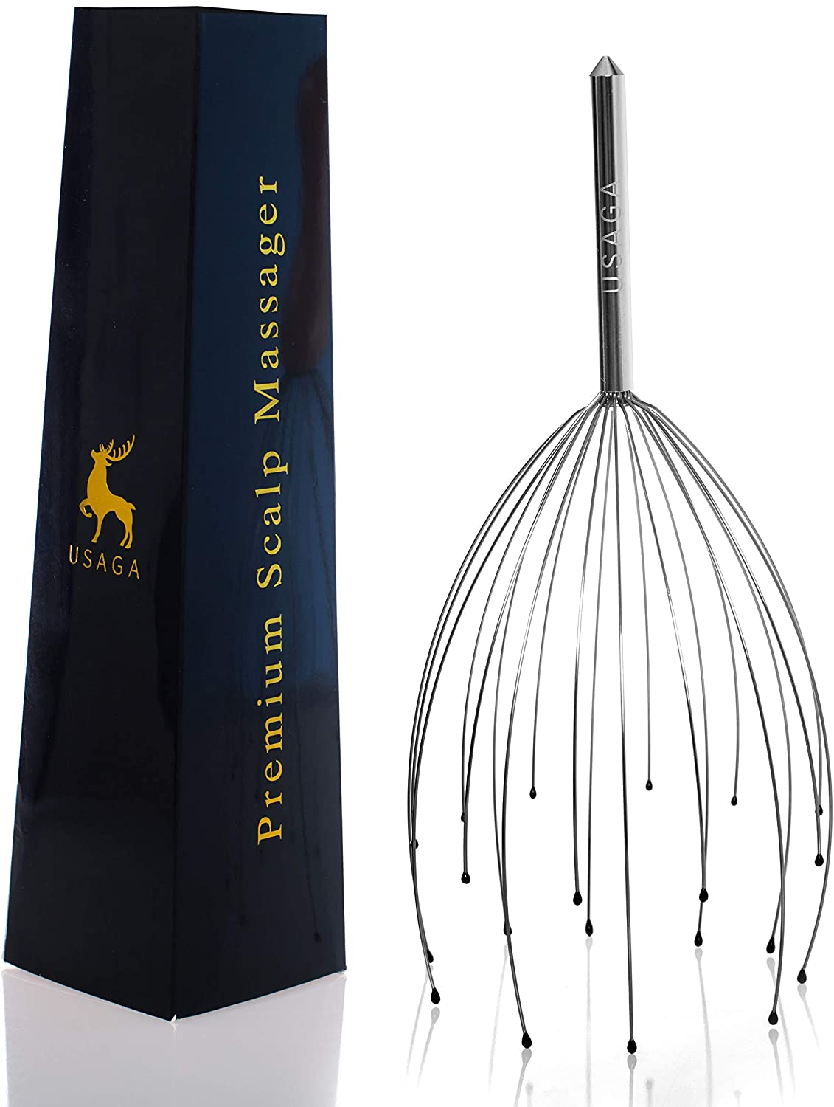
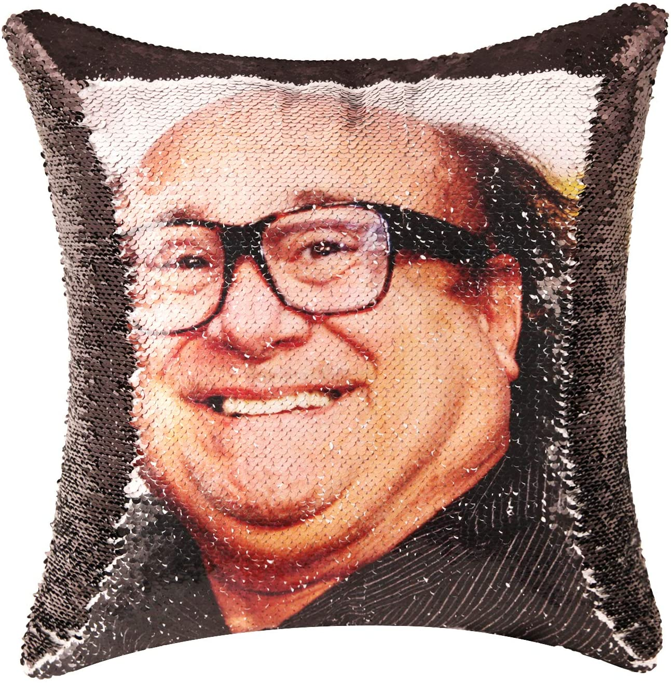



Zoom etiquettes
Write questions into Zoom chat
Feel free to reply to each other — TAs will also reply
I will stop occasionally for Q&A
TAs will re-share some of the questions with me
After each lecture, a random question will get a random reward

Slide 4
Agenda
Goals of ML systems design
Different types of ML systems
Iterative process
Project scoping
Breakout exercise
When to use ML and when not to use ML
Four phases of ML adoption

Slide 5
1. Goals of ML systems design

Slide 6
What’s machine learning systems design?
The process of defining the interface, algorithms, data, infrastructure, and hardware for a machine learning system to satisfy specified requirements.
Notes:
Model is part of algorithms

Slide 7
What’s machine learning systems design?
The process of defining the interface, algorithms, data, infrastructure, and hardware for a machine learning system to satisfy specified requirements.
reliable, scalable, maintainable, adaptable

Slide 8
What’s machine learning systems design?
The process of defining the interface, algorithms, data, infrastructure, and hardware for a machine learning system to satisfy specified requirements.
reliable, scalable, maintainable, adaptable
general software systems
systems that learn from data

Slide 9
Reliability
The system should continue to perform the correct function at the desired level of performance even in the face of adversity (hardware or software faults, and even human error).
What does “correct” mean for ML systems when there are no ground truth labels?
Designing Data-Intensive Applications (Martin Kleppmann, O’Reilly 2017)
Notes:
Choose the correct function
Return the correct label (how do we know it’s correct if we have no ground truth?)

Slide 10
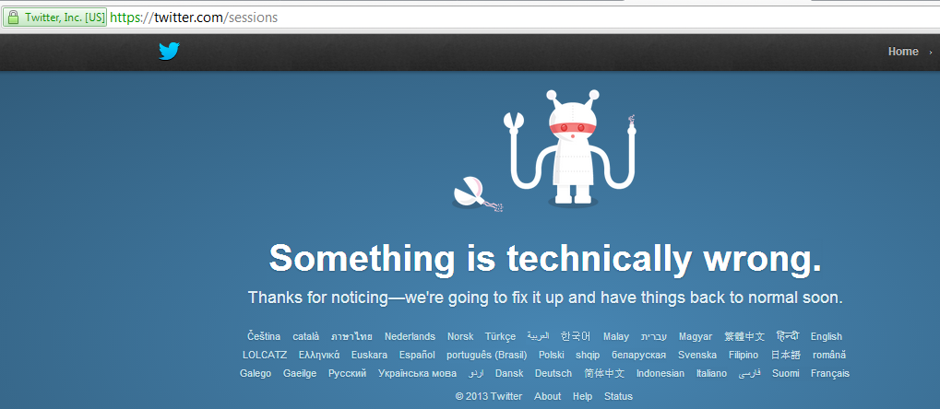
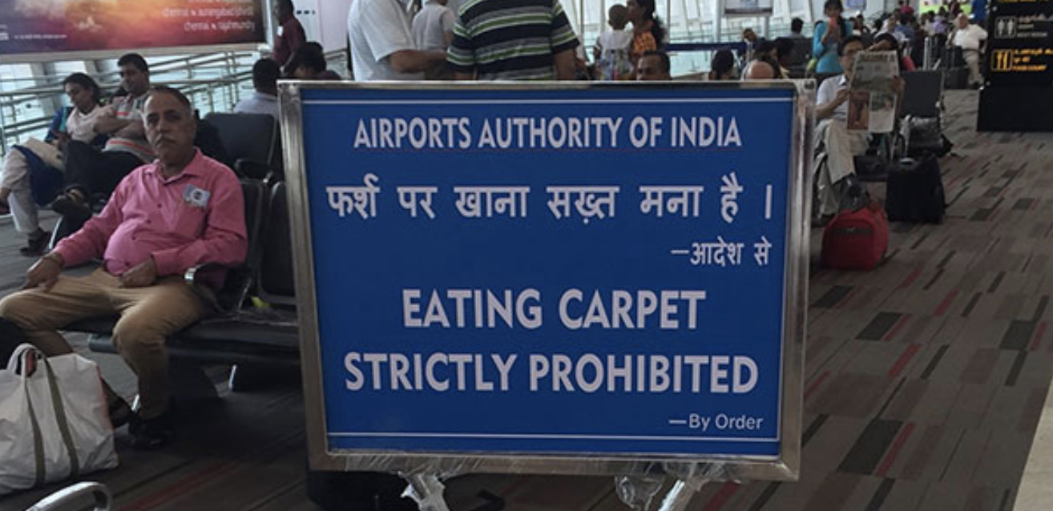
ML systems fail silently
Normal software fails
ML systems fails

Slide 11
Scalability
As the system grows (in data volume, traffic volume, or complexity), there should be reasonable ways of dealing with that growth.
We’ll focus on systems at scale in this course!
Designing Data-Intensive Applications (Martin Kleppmann, O’Reilly 2017)

Slide 12
Scalability
As the system grows (in data volume, traffic volume, or complexity), there should be reasonable ways of dealing with that growth.
Autoscaling: the number of machines can go up or down depending on usage

Slide 13
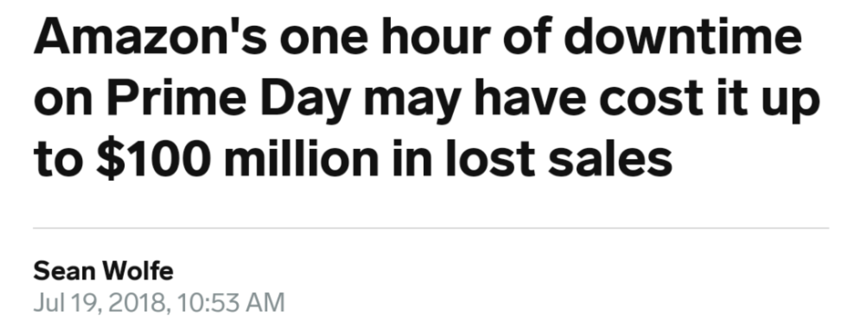
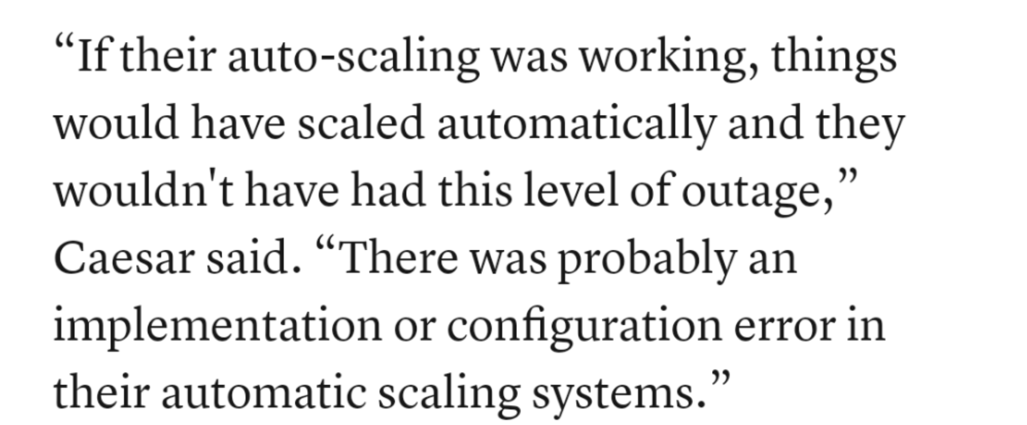
Scalability: cautionary tale
Internal documents show how Amazon scrambled to fix Prime Day glitches (Eugene Kim, CNBC 2018)

Slide 14
Maintainability
Over time, many people (ML engineers, DevOps, subject matter experts) will work on the system, and they should all be able to work on it productively.

Slide 15
The importance of SMEs in ML systems
Subject matter experts (doctors, lawyers, bankers, farmers, stylists, etc.) are not only users but also developers of ML systems.
Domain expertise is needed for:
problem formulation
data labeling
feature engineering
error analysis
model evaluation
reranking predictions

Slide 16
Maintainability: cross-team collaboration
How to help engineers and SMEs communicate effectively?
New hot keywords: no-code / low-code ML

Slide 17
Adaptability
To adapt to changing data distributions and business requirements, the system should have some capacity for both discovering aspects for performance improvement and allowing updates without service interruption.
Linked to maintainability
We’ll cover more about this later!

Slide 18
Need to consider all of this
System
Interface
Data
ML algorithms
Infrastructure
Hardware

Slide 19
2. Different types of ML systems

Slide 20
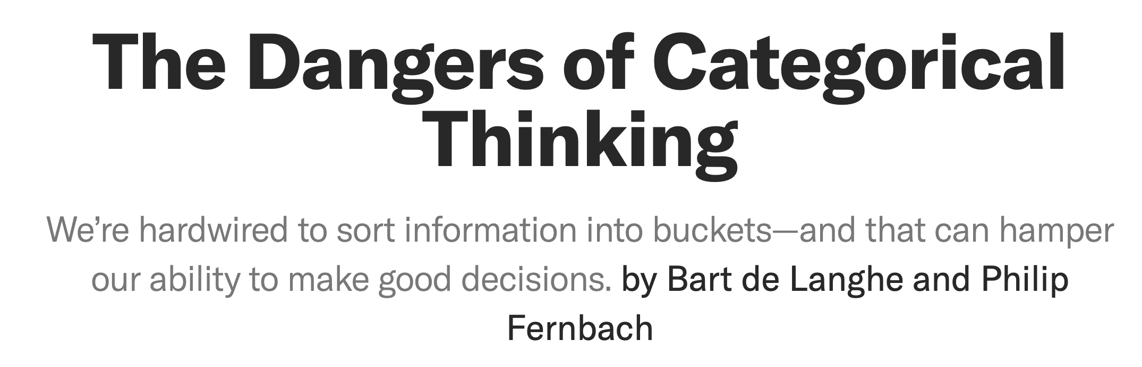
⚠⚠ The dangers of categorical thinking ⚠⚠
Seemingly different ways of doing things might be fundamentally similar
Choices don’t have to be mutually exclusive
Choices can evolve over time

Slide 21

Batch prediction vs. online prediction
Two options for predictions offered by major cloud providers (valid when using your own data centers too)

Slide 22
Batch prediction vs. online prediction
Batch prediction:
Generate predictions periodically
Predictions are stored somewhere (e.g. SQL tables, CSV files)
Retrieve them as needed
Allow more complex models
Online prediction:
Generate predictions as requests arrive
Predictions are returned as responses
⚠ Misnomer ⚠
Both can do one or more samples (batch) at a time
If you do compute on the cloud, then both are technically “online” - over the Internet

Slide 23
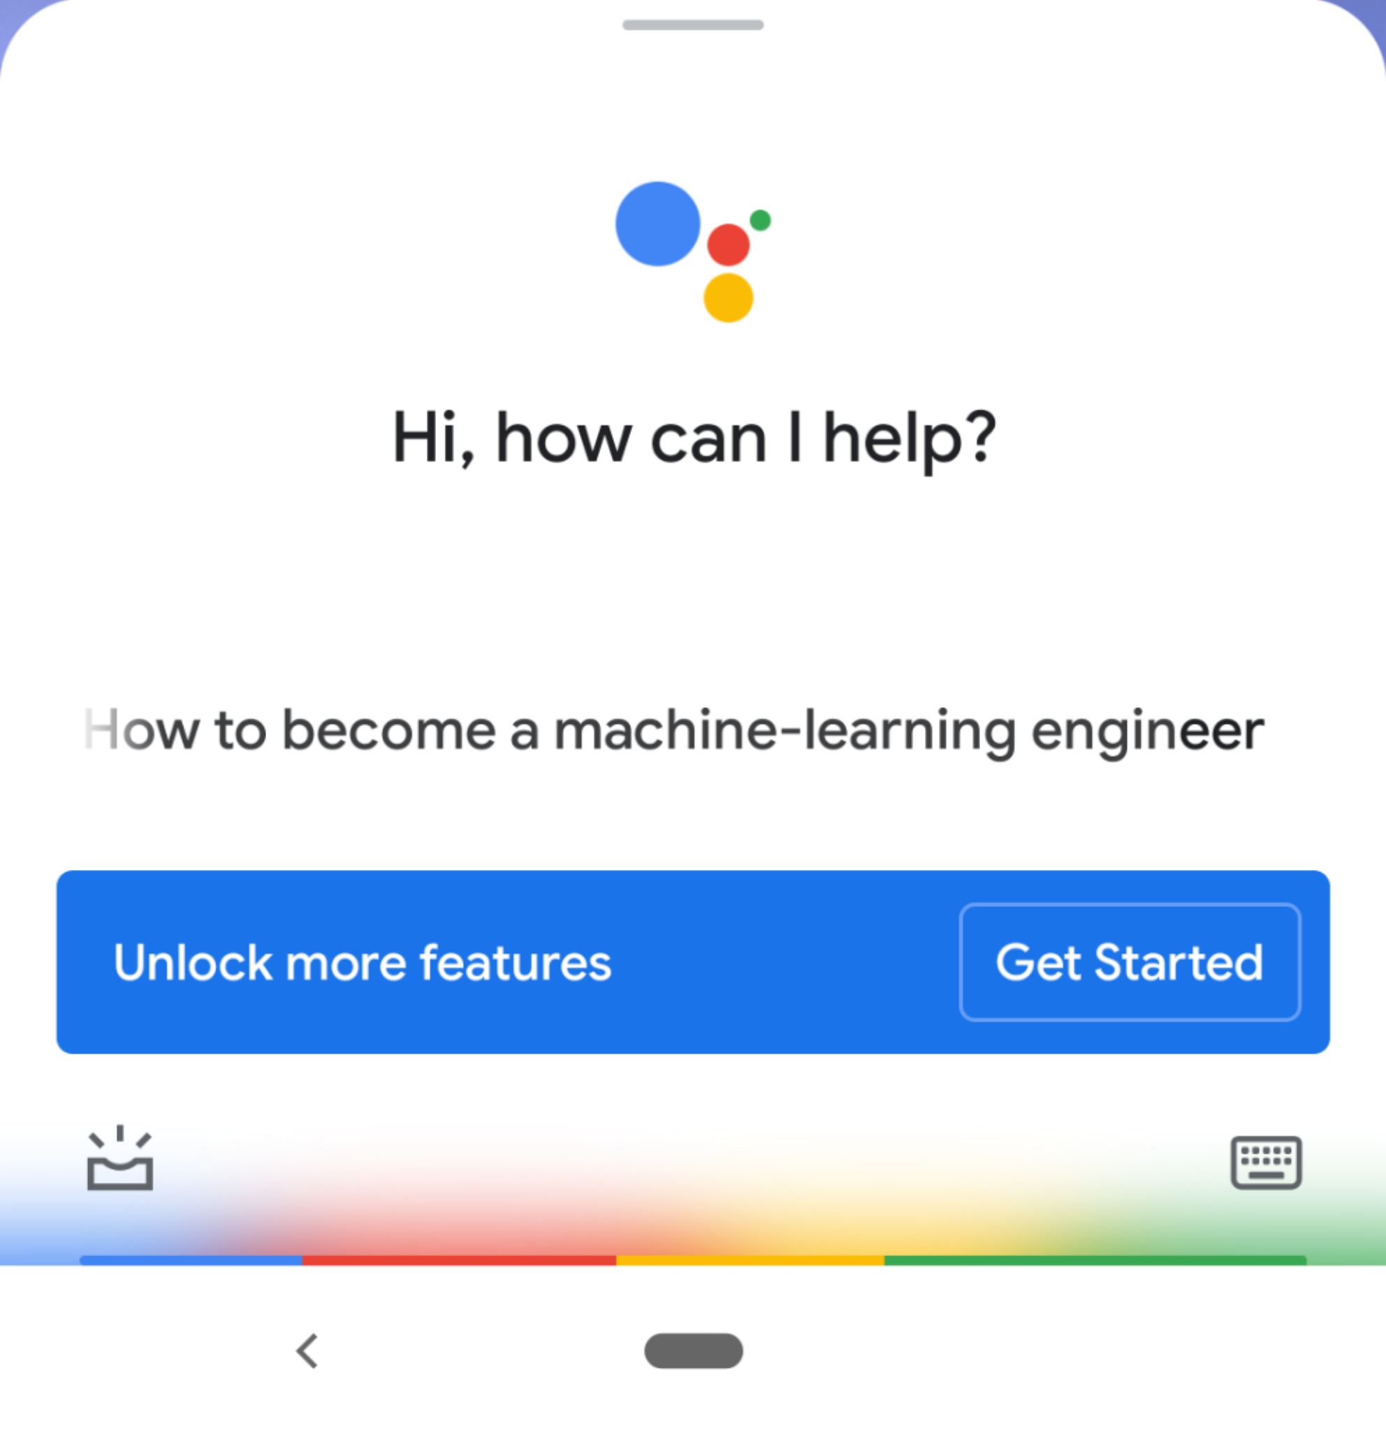
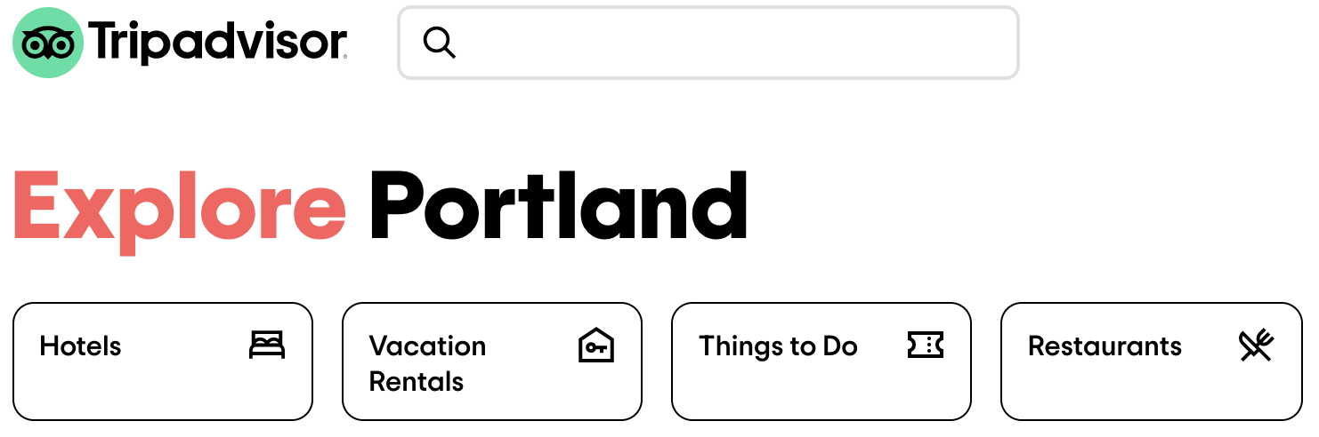
 | Batch prediction | Online prediction
Frequency | Periodical (e.g. every 4 hours) | As soon as requests come
Useful for | Processing accumulated data when you don't need immediate results (e.g. recommendation systems) | When predictions are needed as soon as data sample is generated (e.g. fraud detection)
Optimized | High throughput | Low latency
Input space | Finite: need to know how many predictions to generate | Can be infinite
Examples | TripAdvisor hotel ranking Netflix recommendations | Google Assistant speech recognition Twitter feed

Slide 24


Hybrid: batch & online prediction
Online prediction is default, but common queries are precomputed and stored
Restaurant recommendations use batch predictions
Within each restaurant, item recommendations use online predictions
Title recommendations use batch predictions
Row orders use online predictions

Slide 25
Edge computing vs. cloud computing

Slide 26
 | Cloud computing | Edge computing
Computations | Done on cloud (servers) | Done on edge devices (browsers, phones, tablets, laptops, smart watches, activity watchers, cars, etc.)
Requirements | Network connections: availability and speed for data transfer | Hardware: memory, compute power, energy for doing computations
Examples | Most queries to Alexa, Siri, Google Assistant Google Translate for rare language pairs (e.g. English - Yiddish) | Wake words for Alexa, Siri, Google Assistant Google Translate for popular language pairs (e.g. English - Spanish) Predictive text Unlocking with fingerprints, faces

Slide 27
Benefits of edge computing
Can work without (Internet) connections or with unreliable connections
Many companies have strict no-Internet policy
Caveat: devices are capable of doing computations but apps need external information
e.g. ETA needs external real-time traffic information to work well
Don’t have to worry about network latency
Network latency might be a bigger problem than inference latency
Many use cases are impossible with network latency
e.g. predictive texting
Fewer concerns about privacy
Don’t have to send user data over networks (which can be intercepted)
Cloud database breaches can affect many people
Easier to comply with regulations (e.g. GDPR)
Caveat: edge computing might make it easier to steal user data by just taking the device
Cheaper
The more computations we can push to the edge, the less we have to pay for servers

Slide 28
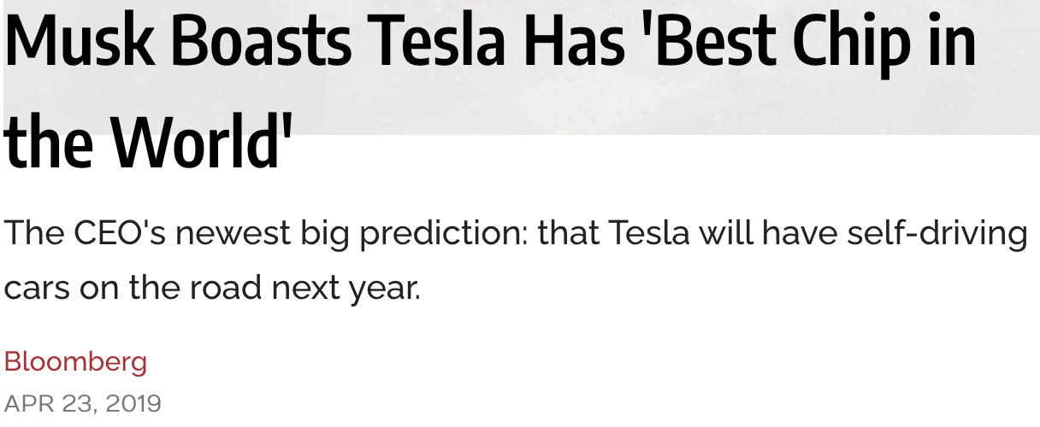
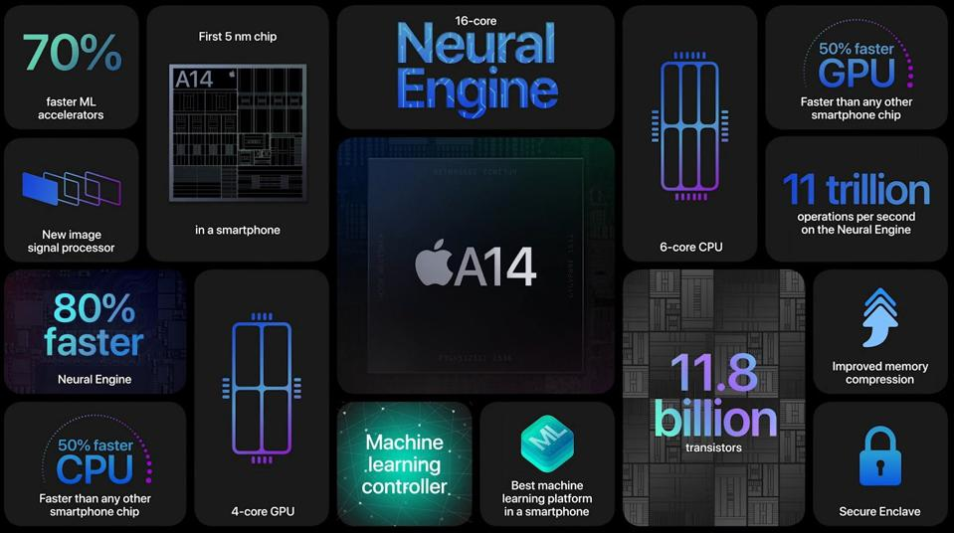
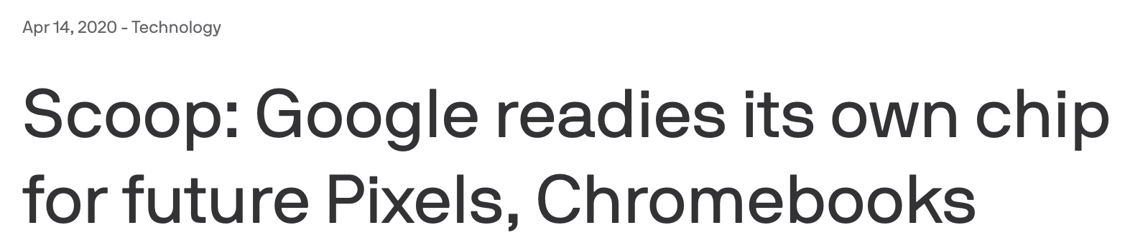
Many companies invest heavily in better chips
⚠ unreliable narrator ⚠
More on edge devices later!

Slide 29
Hybrid
Common predictions are precomputed and stored on device
Local data centers: e.g. each warehouse has its own server rack
Predictions are generated on cloud and cached on device

Slide 30
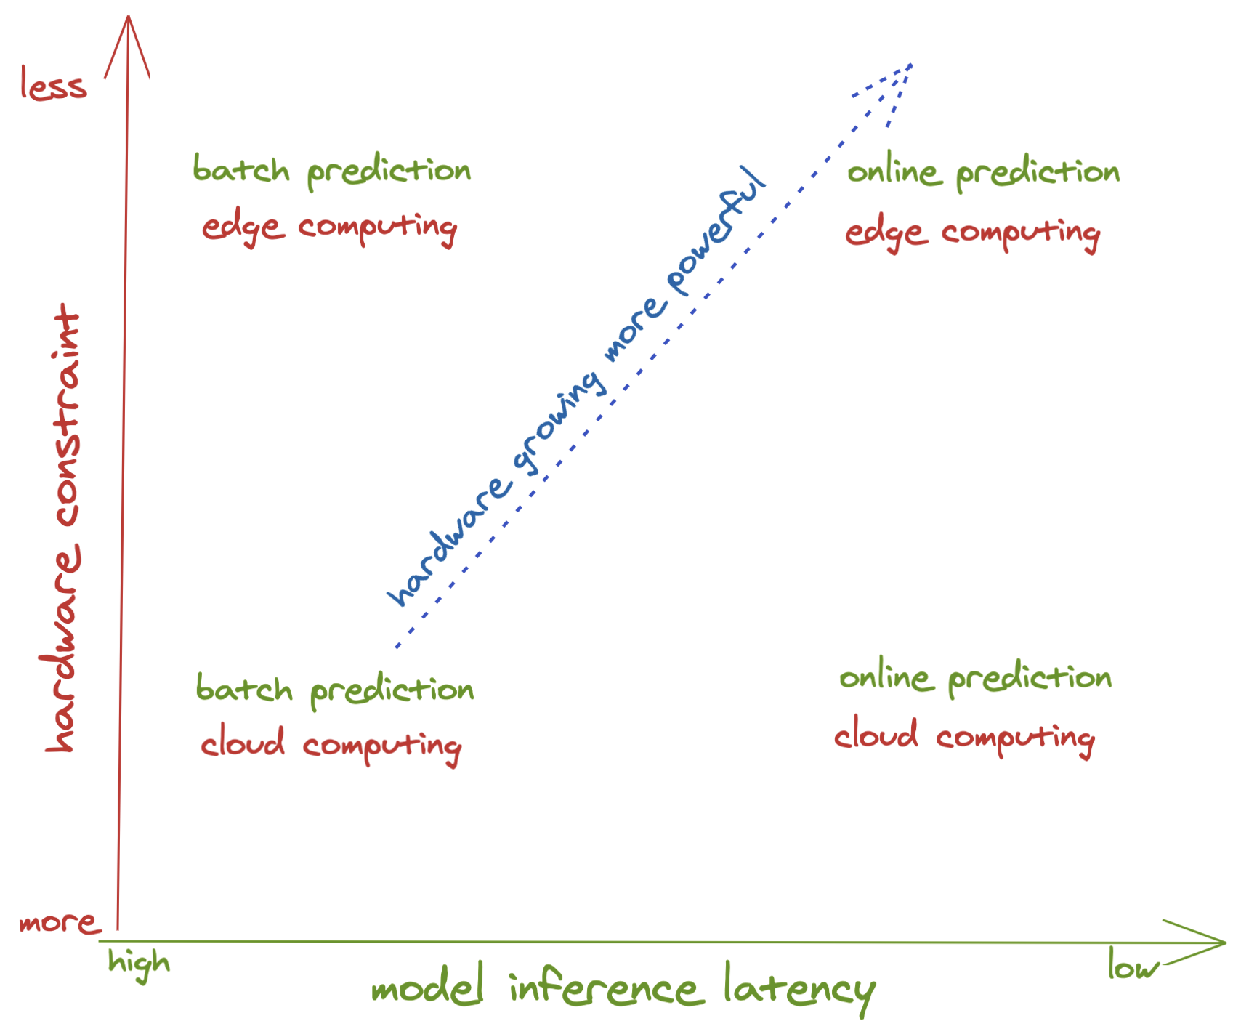


Future of ML: online and on-device
Notes:
Likely examples: step counting

Slide 31
Offline learning vs. online learning
Harder & less common

Slide 32
 | Offline learning | Online learning
Iteration cycle | Periodical (months) | Continual (minutes)
Batch size | batch (thousands -> millions of samples) GPT-3 125M params: batch size 0.5M GPT-3 175B params: batch size 3.2M | microbatch (hundreds of samples)
Data usage | Each sample seen multiple times (epochs) | Each sample seen at most once
Evaluation | Mostly offline evaluation | Offline evaluation as sanity check Mostly relying on online evaluation (A/B testing)
Examples | Most applications | TikTok recommendation system, Twitter hashtag trending
continuous

Slide 33
Online learning vs. offline learning
Both can be done together to create more stable systems
If the infrastructure is set up right, there’s no fundamental difference between online learning and offline learning, just a hyperparam to tune.
More on online learning later!

Slide 34
3. Iterative process

Slide 35

ML in production: expectation
Collect data
Train model
Deploy model

Slide 36
ML in production: reality
Choose a metric to optimize
Collect data
Train model
Realize many labels are wrong -> relabel data
Train model
Model performs poorly on one class -> collect more data for that class
Train model
Model performs poorly on most recent data -> collect more recent data
Train model
Deploy model
Dream about $$$
Wake up at 2am to complaints that model biases against one group -> revert to older version
Get more data, train more, do more testing
Deploy model
Pray
Model performs well but revenue decreasing
Cry
Choose a different metric
Start over
Step 15 and 17 are essential

Slide 37
ML in production: expectation
Collect data
Train model
Deploy model
Collect data
Train model
Deploy model
Waterfall model

Slide 38
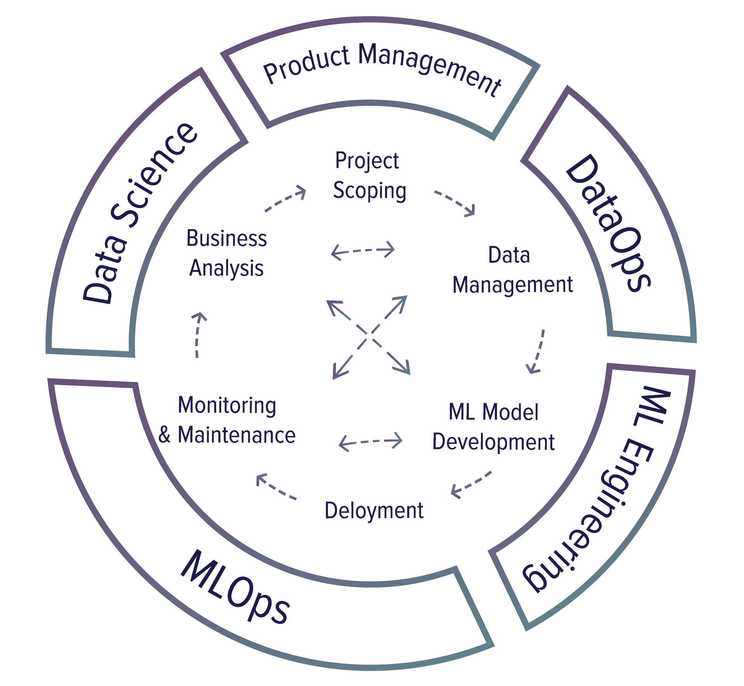
ML in production: reality
Choose a metric to optimize
Collect data
Train model
Realize many labels are wrong -> relabel data
Train model
Model performs poorly on one class -> collect more data for that class
Train model
Model performs poorly on most recent data -> collect more recent data
Train model
Deploy model
Dream about $$$
Wake up at 2am to complaints that model biases against one group -> revert to older version
Get more data, train more, do more testing
Deploy model
Pray
Model performs well but revenue decreasing
Cry
Choose a different metric
Start over
Iterative development

Slide 39
Project scoping
Goals & objectives
Constraints
Evaluation

Slide 40
Data management
Data sources
Data format
Processing
Storage
Data consumer
Data controller

Slide 41
Model development
Dataset creation
Feature engineering
Model training
Offline model evaluation

Slide 42
Deployment
Deploying and serving
Release strategies
Online model evaluation

Slide 43
Monitoring & maintenance
Model performance & data monitoring
Model retraining
Model updates

Slide 44
Business analysis
User experience
Tying model performance to business performance

Slide 45
4. Project scoping

Slide 46
Goals
“The social responsibility of a business is to increase its profits.”
Milton Friedman (The New York Times, 1970)

Slide 47
Goals
The ultimate goal of an ML project or any project within a business is, therefore, to increase profits directly or indirectly.
Directly: increasing sales (ads, conversion rates), cutting costs
Indirectly: increasing customer satisfaction, increasing time spent on a website
Non-profits are exceptions: lots of exciting applications of AI for social good
environment (climate change, deforestation, flood risk, etc.)
public health
education (intelligent tutoring system, personalized learning)

Slide 48
ML to business performance can be confusing
An ML model that gives customers more personalized solutions can either:
make them happier which makes them spend more money
solve their problems faster which makes them spend less money

Slide 49
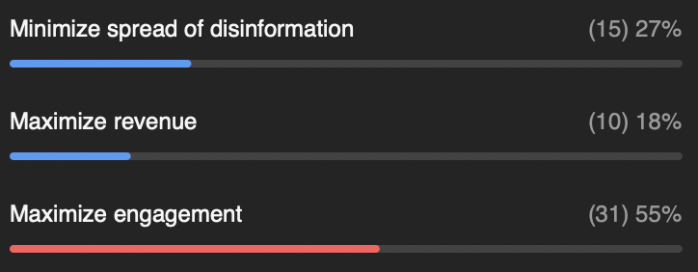
Example
Possible goals when building a ranking system for newsfeed?
minimize the spread of misinformation
maximize revenue from sponsored content
maximize engagement
Zoom poll: which goal would you choose?
Notes:
TODO: a poll here

Slide 50
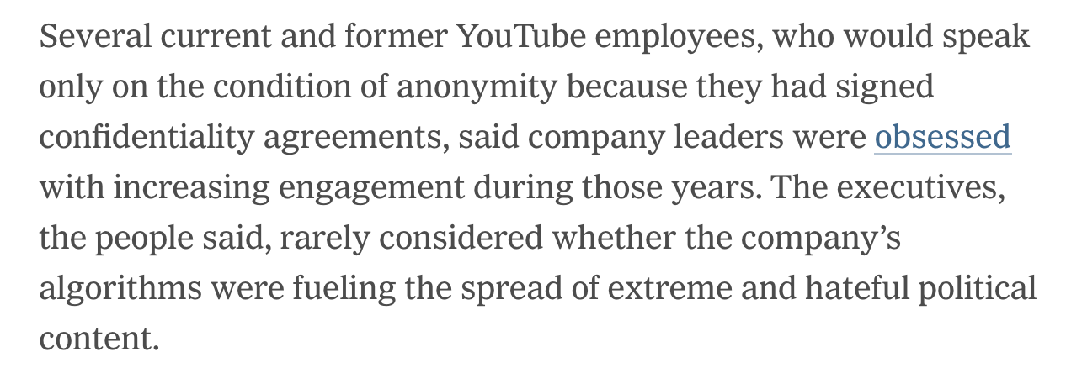
Side note: ethics of maximizing engagement
Facebook Employee Raises Powered by ‘Really Dangerous’ Algorithm That Favors Angry Posts (SFist, 2019)
The Making of a YouTube Radical (NYT, 2019)

Slide 51
Objectives
Goals | Objectives
General purpose of a project | Specific steps on how to realize that purpose

Slide 52
Example: ranking system for newsfeed
Goals | Objectives
General purpose of a project | Specific steps on how to realize that purpose
Maximize users’ engagement | Filter out spam Filter out NSFW content Rank posts by engagement: how likely users will click on it

Slide 53
Example: ranking system for wholesome newsfeed
Goals | Objectives
General purpose of a project | Specific steps on how to realize that purpose
Maximize users’ engagement while minimizing the spread of extreme views and misinformation | Filter out spam Filter out NSFW content Filter out misinformation Rank posts by quality Rank posts by engagement: how likely users will click on it

Slide 54
Example: ranking system for wholesome newsfeed
Goals | Objectives
General purpose of a project | Specific steps on how to realize that purpose
Maximize users’ engagement while minimizing the spread of extreme views and misinformation | Filter out spam Filter out NSFW content Filter out misinformation Rank posts by quality Rank posts by how likely users will click on it
How to combine these two objectives?

Slide 55
Multiple objective optimization (MOO)
Rank posts by quality
Predict posts’ quality
Minimize quality_loss: difference between predicted quality and true quality
Rank posts by how likely users will click on it
Predict posts’ engagement
Minimize engagement_loss: difference between predicted clicks and true clicks

Slide 56
MOO: one model with combined loss
Rank posts by quality
Predict posts’ quality
Minimize quality_loss: difference between predicted quality and true quality
Rank posts by how likely users will click on it
Predict posts’ engagement
Minimize engagement_loss: difference between predicted clicks and true clicks
loss = 𝛼 quality_loss + 𝛽 engagement_loss
Train one model to minimize this combined loss
Tune 𝛼 and 𝛽 to meet your need
Side note 1: check out Pareto optimization if you want to learn about how to choose 𝛼 and 𝛽

Slide 57
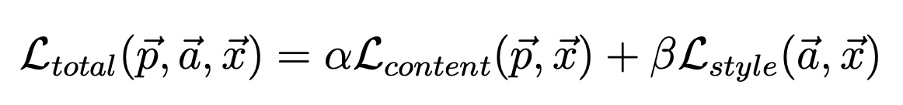
MOO: one model with combined loss
Rank posts by quality
Predict posts’ quality
Minimize quality_loss: difference between predicted quality and true quality
Rank posts by how likely users will click on it
Predict posts’ engagement
Minimize engagement_loss: difference between predicted clicks and true clicks
loss = 𝛼 quality_loss + 𝛽 engagement_loss
Train one model to minimize this combined loss
Side note 2: this is quite common, e.g. style transfer
A Neural Algorithm of Artistic Style (Gatys et al, 2017)

Slide 58
MOO: one model with combined loss
Rank posts by quality
Predict posts’ quality
Minimize quality_loss: difference between predicted quality and true quality
Rank posts by how likely users will click on it
Predict posts’ engagement
Minimize engagement_loss: difference between predicted clicks and true clicks
loss = 𝛼 quality_loss + 𝛽 engagement_loss
Train one model to minimize this combined loss
⚠ Every time you want to tweak 𝛼 and 𝛽, you have to retrain your model! ⚠

Slide 59
MOO: combine different models
Rank posts by quality
Predict posts’ quality
Minimize quality_loss: difference between predicted quality and true quality
Rank posts by how likely users will click on it
Predict posts’ engagement
Minimize engagement_loss: difference between predicted clicks and true clicks
M_{q}: optimizes quality_loss
M_{e}: optimizes engagement_loss
Rank posts by 𝛼 M_{q}(post) + 𝛽 M_{e}(post)
Now you can tweak 𝛼 and 𝛽 without retraining models

Slide 60
Decouple different objectives
Easier for training:
Optimizing for one objective is easier than optimizing for multiple objectives
Easier to tweak your system:
E.g. 𝛼 % model optimized for quality + 𝛽 % model optimized for engagement
Easier for maintenance:
Different objectives might need different maintenance schedules
Spamming techniques evolve much faster than the way post quality is perceived
Spam filtering systems need updates more frequently than quality ranking systems
Notes:
Example of why ML systems need to adapt quickly to evolving environments

Slide 61
Constraints: time & budget
Time
Rule of thumb: 20% time to get initial working system, 80% on iterative development
Budget
Data, resources, talent
Possible time/budget tradeoffs:
Use more/more powerful machines to get things done faster
Hire more people to label more data/run more experiments
Buy existing solutions

Slide 62
Constraints: performance
Baselines
Existing solutions, simple solutions, human experts, competitors solutions, etc.

Slide 63
Constraints: performance
Baselines
Usefulness threshold
Self-driving needs human-level performance. Predictive texting doesn’t.

Slide 64
Constraints: performance
Baselines
Usefulness threshold
False negatives vs. false positives
Covid screening: no false negative (patients with covid shouldn’t be classified as no covid)
Fingerprint unlocking: no false positive (unauthorized people shouldn’t be given access)

Slide 65
Constraints: performance
Baselines
Usefulness threshold
False negatives vs. false positives
Interpretability
Does it need to be interpretable? If yes, to whom?

Slide 66
Constraints: performance
Baselines
Usefulness threshold
False negatives vs. false positives
Interpretability
Confidence measurement (how confident it is about a prediction)
Does it need confidence measurement?
Is there a confidence threshold? What to do with predictions below that threshold—discard it, loop in humans, or ask for more information from users?

Slide 67
Constraints: performance
Baselines
Existing solutions, simple solutions, human experts, competitors solutions, etc.
Usefulness threshold
Self-driving needs human-level performance. Predictive texting doesn’t.
False negatives vs. false positives
Covid screening: no false negative (patients with covid shouldn’t be classified as no covid)
Fingerprint unlocking: no false positive (unauthorized people shouldn’t be given access)
Interpretability
Does it need to be interpretable? If yes, to whom?
Confidence measurement (how confident it is about a prediction)
Does it need confidence measurement?
Is there a confidence threshold? What to do with predictions below that threshold—discard it, loop in humans, or ask for more information from users?

Slide 68
Constraints: privacy
Privacy requirements for annotation, storage, third-party solutions, cloud services, regulations
Can data be shipped outside organizations for annotation?
Can the system be connected to the Internet?
How long can you keep users data?

Slide 69
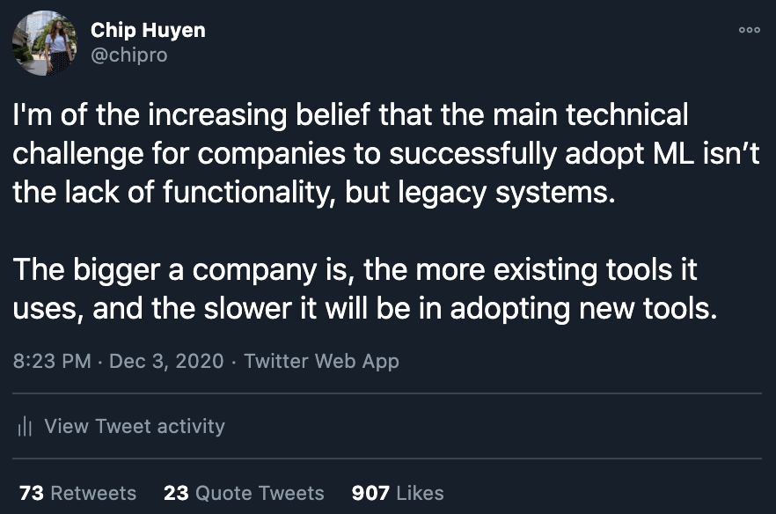
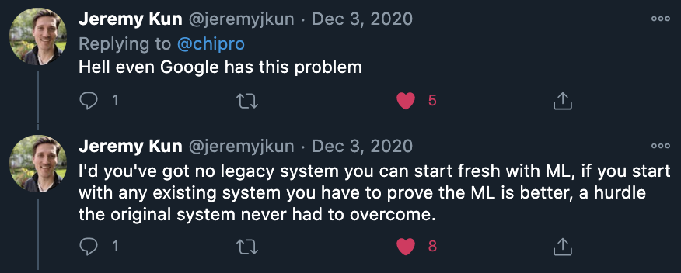
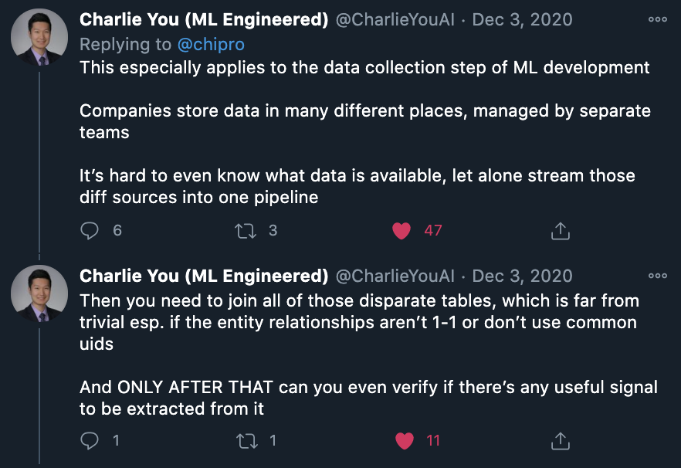
Constraints: technical constraints
Competitors
Legacy systems
Notes:
Today in Tweets are not academic evidences

Slide 70
Evaluation
How to evaluate models during training?
How to evaluate models in serving, when there’s no hand-labeled ground truths?

Slide 71
5. Breakout exercise

Slide 72
10 mins - group of 4
Each question on Quora often gets many different answers. How would you build a system to rank the answers?
Some aspects to consider:
Goals and objectives?
Constraints
What should labels be?
What features to include?
How to evaluate models, during training & in production?
How to collect data?
OK to google
Don’t forget to introduce yourself to your teammates!

Slide 73
6. When to use ML

Slide 74
Machine learning is an approach to learn complex patterns from existing data and use these patterns to make predictions on unseen data.

Slide 75
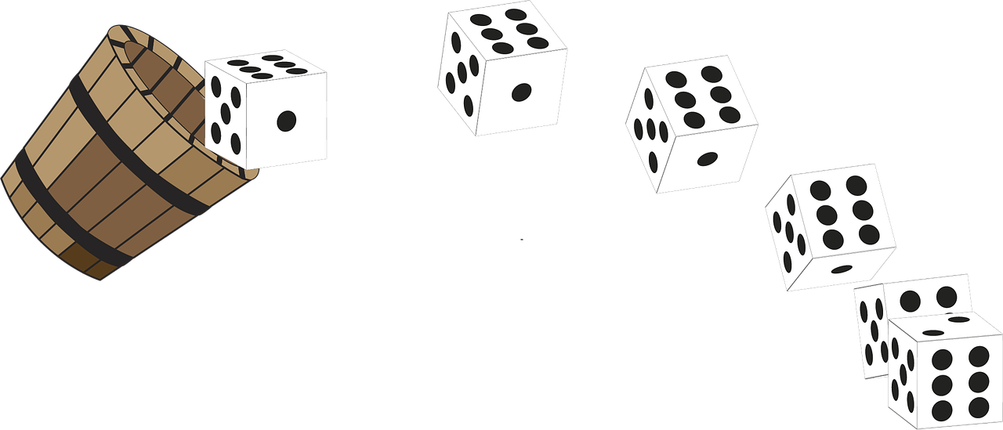
Patterns: there must be patterns to learn

Slide 76
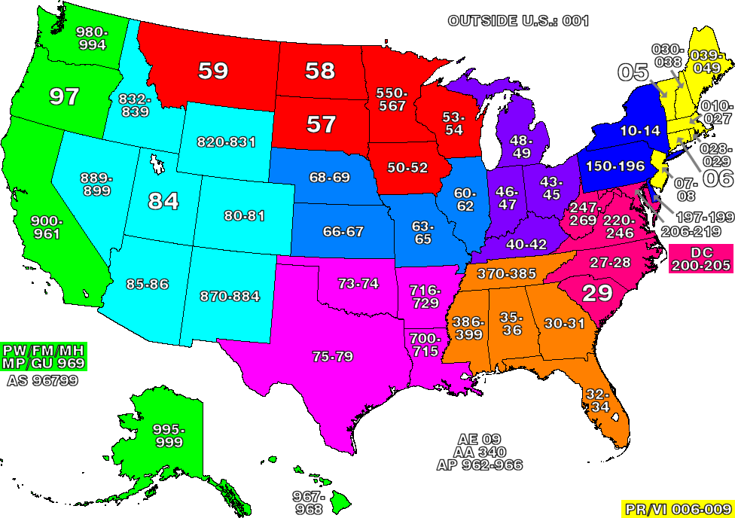
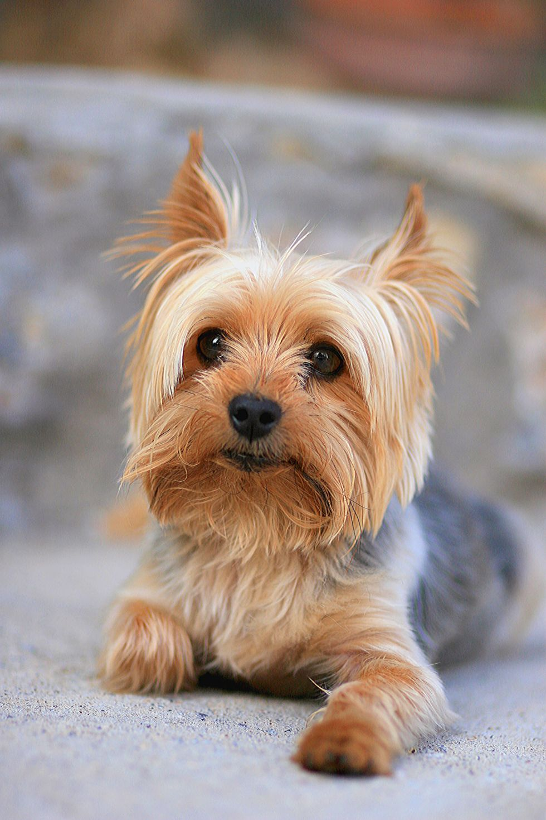
Complex: the patterns are complex
Simple
Complex

Slide 77
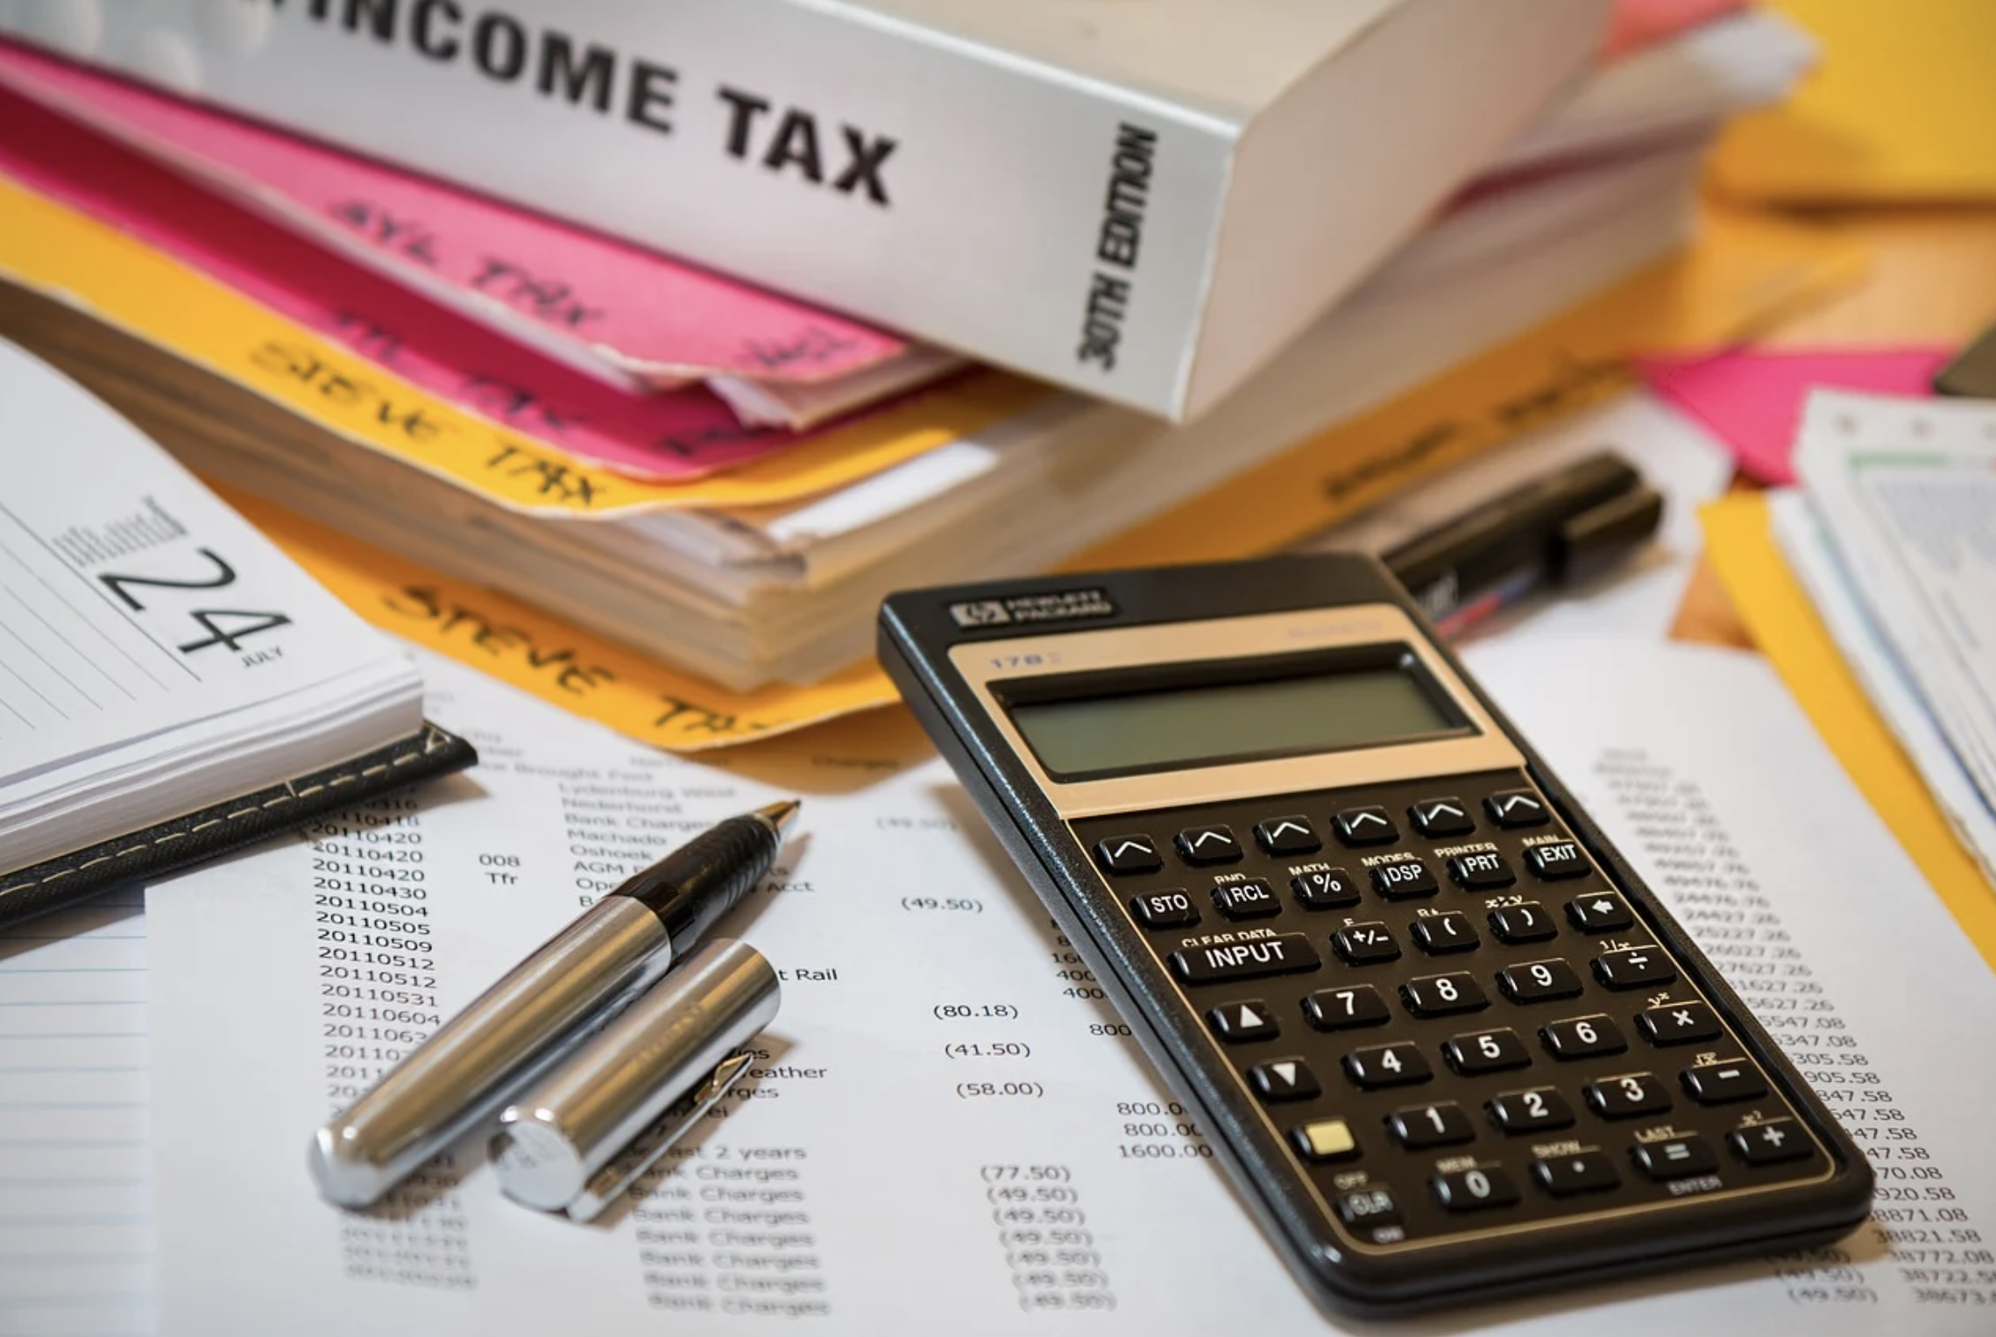
Existing data: it’s possible to collect
Notes:
Inaccessible for some but not for others

Slide 78

Unseen data: the patterns generalize
Notes:
Example: predicting app download number based on data from 2009

Slide 79

Predictions: it’s a predictive problem

Slide 80
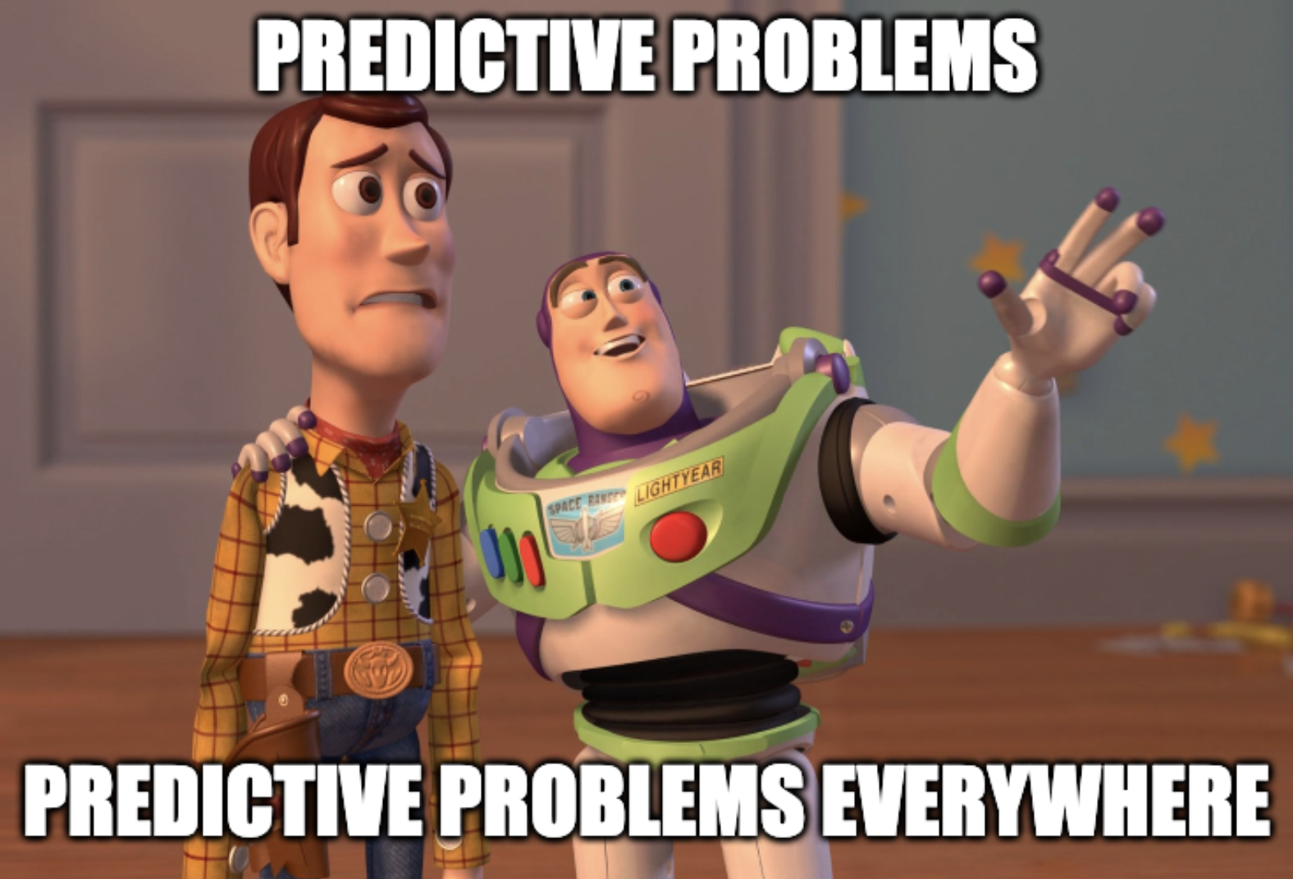
A question can be turned into a predictive problem by asking:
What would the answer/solution look like?

Slide 81
When not to use ML
It’s unethical.
Simpler solutions do the trick.
It’s impossible to get the right data.
One single prediction error can cause devastating consequences.
Every single decision the system makes must be explainable.
It’s not cost-effective.

Slide 82
When not to use ML
It’s unethical.
Simpler solutions do the trick.
It’s impossible to get the right data.
One single prediction error can cause devastating consequences.
Every single decision the system makes must be explainable.
It’s not cost-effective.
Caution: it might not be cost-effective now but might be in the future

Slide 83
If ML isn’t the solution, it can be part of it
Break your problem into smaller problems. ML might be able to solve some of them.
If a chatbot can’t answer all customers’ queries, build an ML model to predict whether a query matches one of the frequently asked questions.
Human-in-the-loop

Slide 84
7. Four phases of ML adoption

Slide 85
Phase 1: Before ML
“If you think that machine learning will give you a 100% boost, then a heuristic will get you 50% of the way there.”
Martin Zinkevich, Google

Slide 86
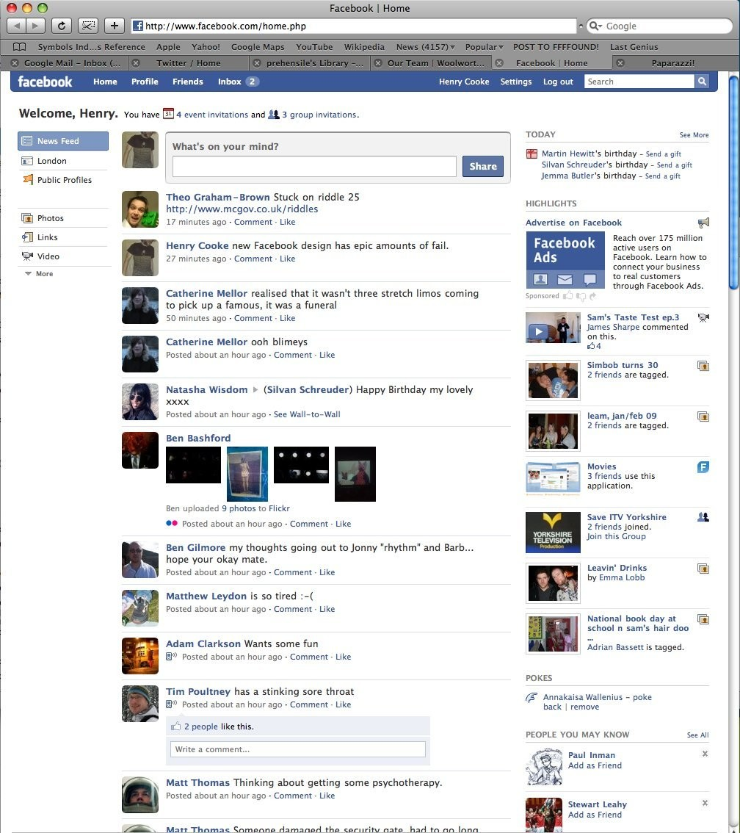
https://newsfeed.org/what-mark-zuckerbergs-news-feed-looked-like-in-2006/

Slide 87
Phase 2: Simplest ML models
Start with a simple model that allows visibility into its working to:
validate hypothesis
validate pipeline

Slide 88
Phase 3: Optimizing simple models
Different objective functions
Feature engineering
More data
Ensembling

Slide 89

Phase 4: Complex ML models

Slide 90
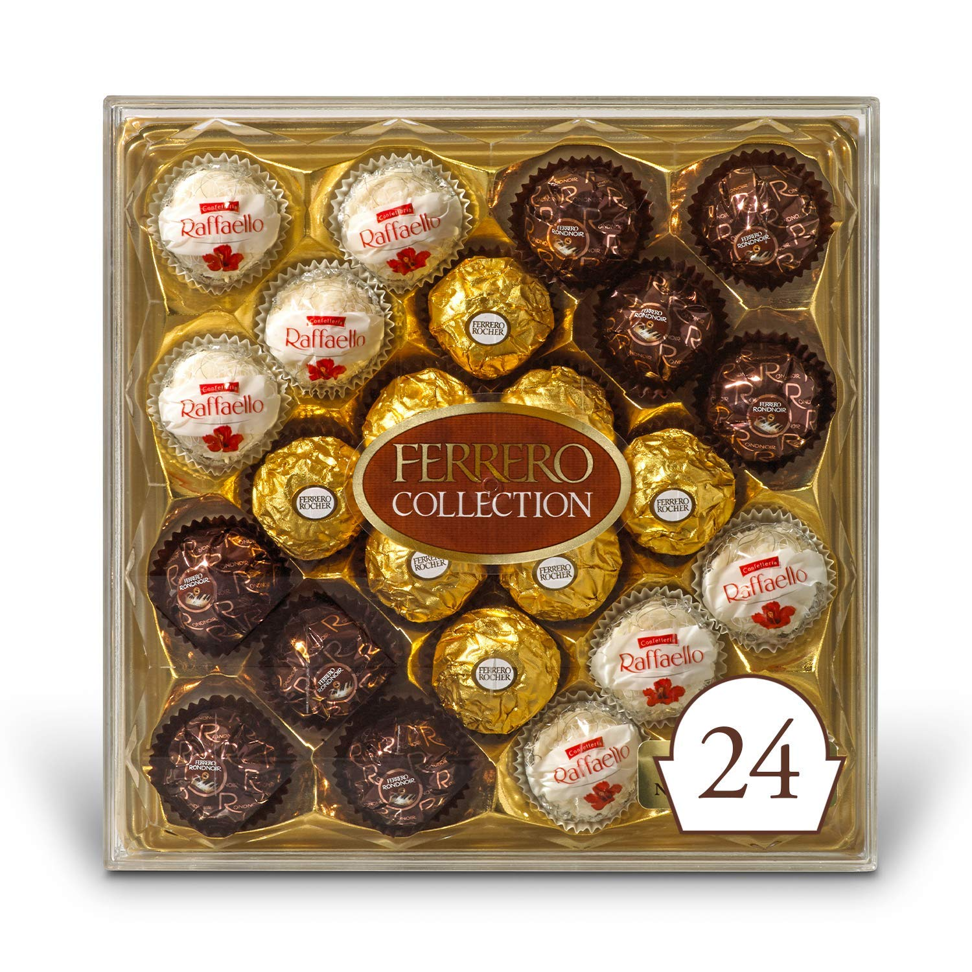



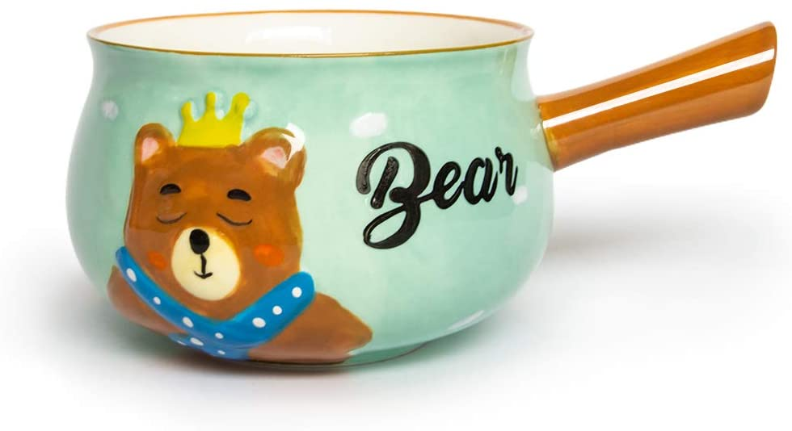
Notes:
Choose a random number from 1 to 10

Slide 91
4 2 8 6 10
John got a mug warmer!
7 1 3 5 9

Slide 92
Machine Learning Systems Design
Next class: Data engineering
cs329s.stanford.edu | Chip Huyen

